Slide 1

Group leader: Hiba Zehra(BSE-23F-155)
Group members:
Zainab Anwer(BSE-23F-106)
Kumkum(BSE-23F-162)
Submitted To: Miss Aqsa Umer

Slide 2


Slide 3
Introduction
A library management system, also known as an automated library system is software that has been develop to handle basic housekeeping function of a library.

Slide 4
Entity-Relationship Diagram (ERD)
An Entity-Relationship Diagram (ERD) is data modeling technique.
An ERD is an conceptual representational model of data.
An Entity-Relationship Diagram (ERD) is a snapshot of data structures.
An ERD shows entities tables in a database and relationships between tables within that database.

Slide 5
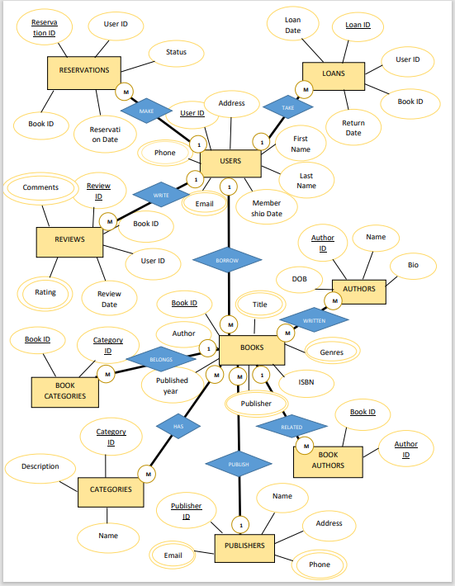
ER Model

Slide 6
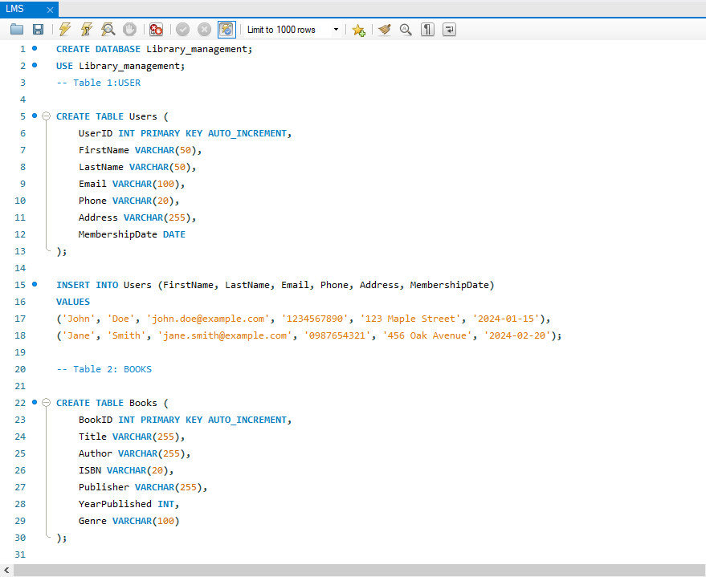
Contributions
Zainab Anwar: 1. SQL Main File:

Slide 7
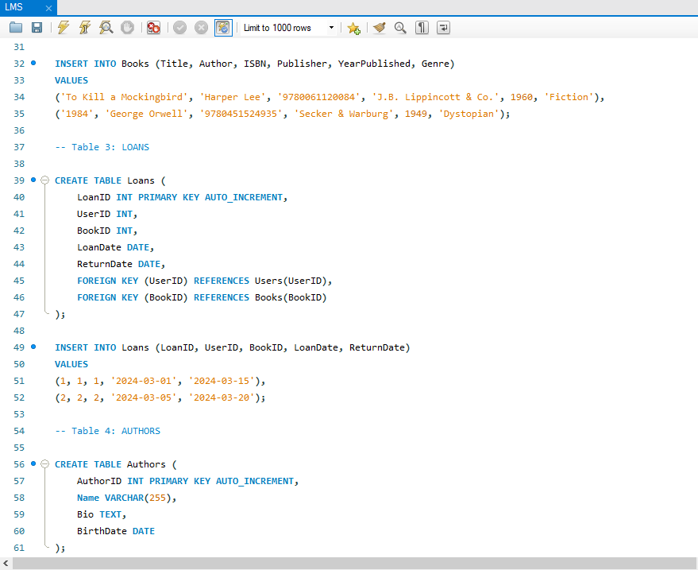
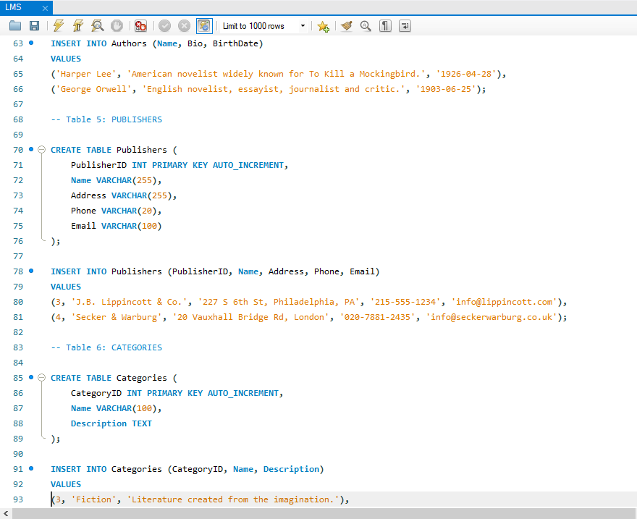

Slide 8
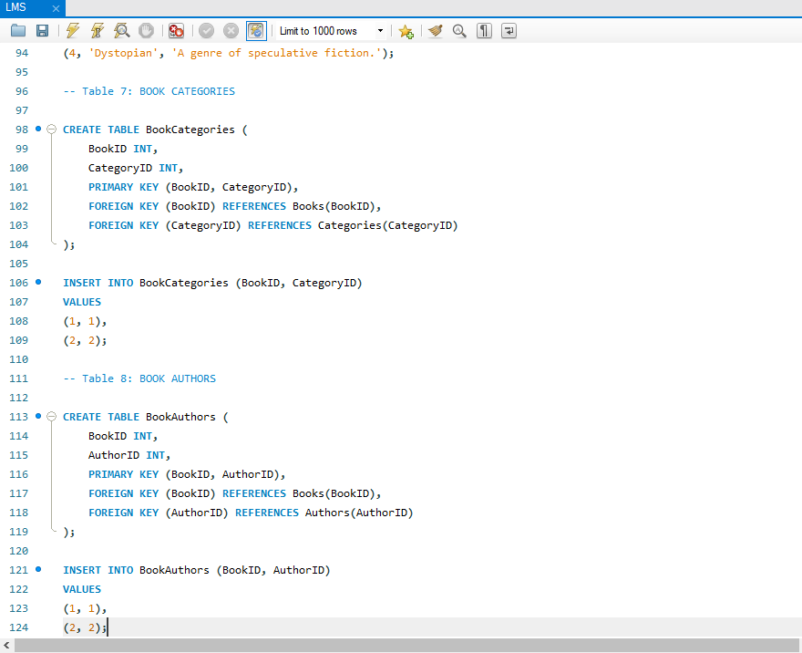
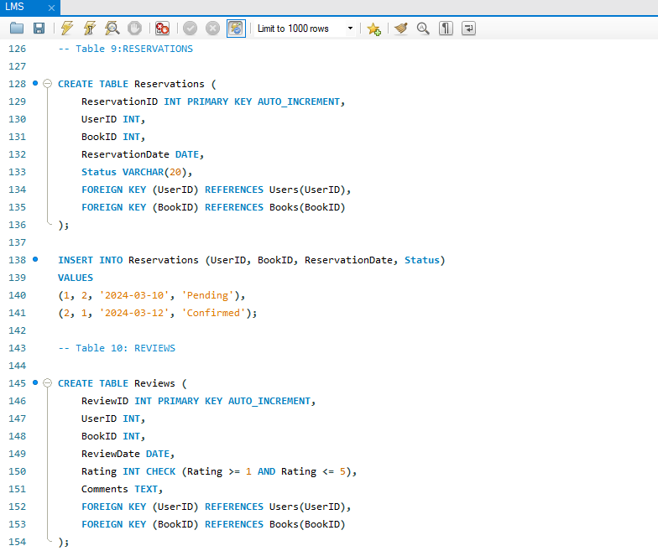

Slide 9
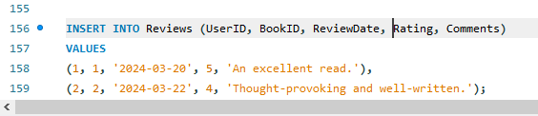
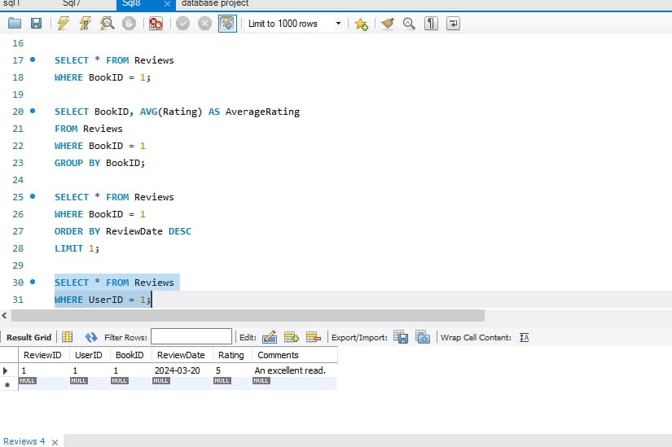
2. Queries: Table 1:

Slide 10
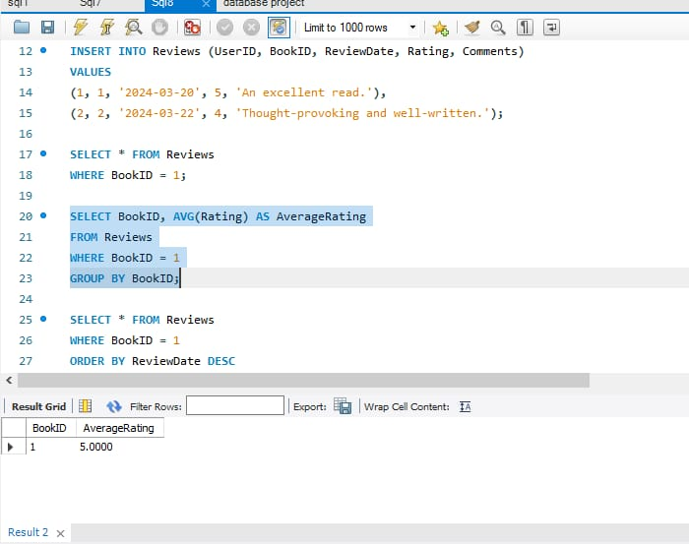
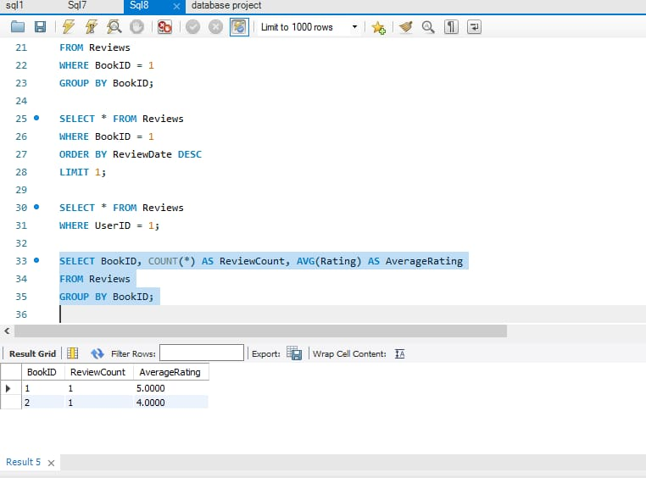

Slide 11
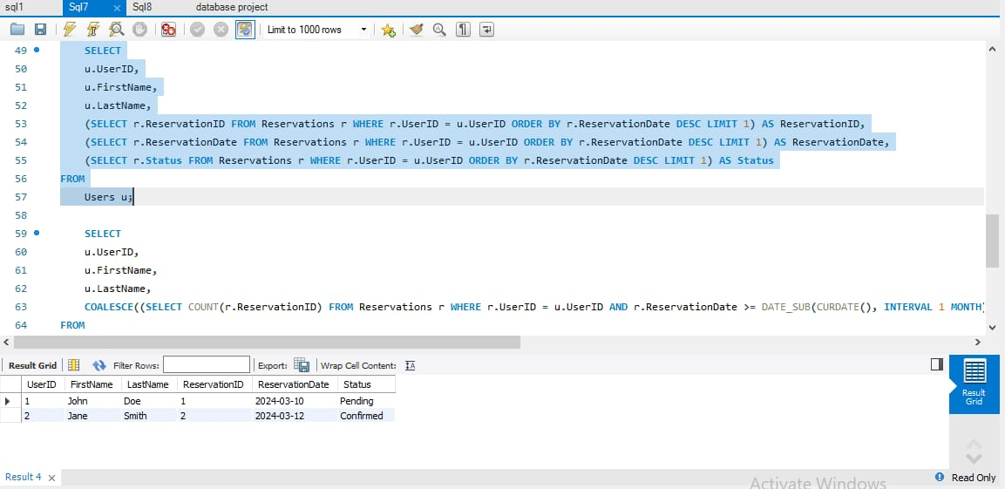
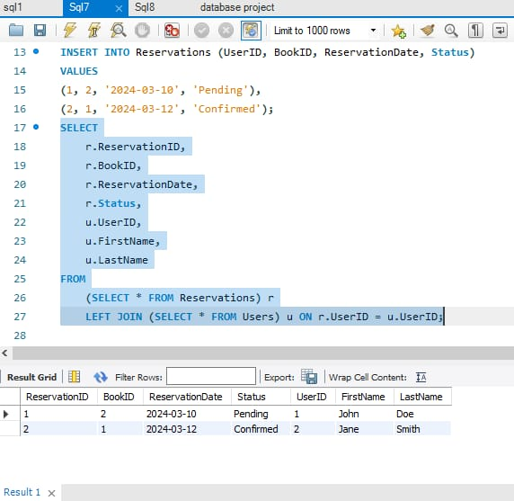
Table 2:

Slide 12
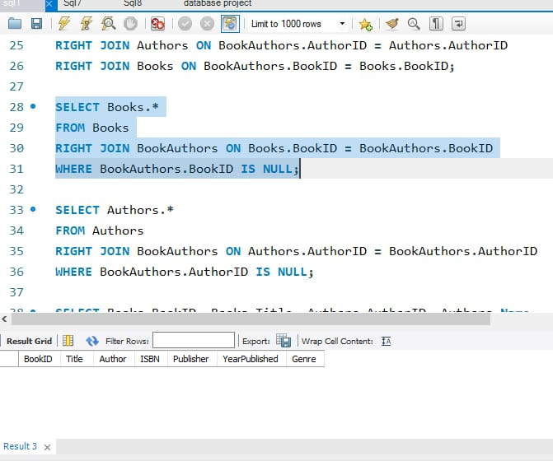
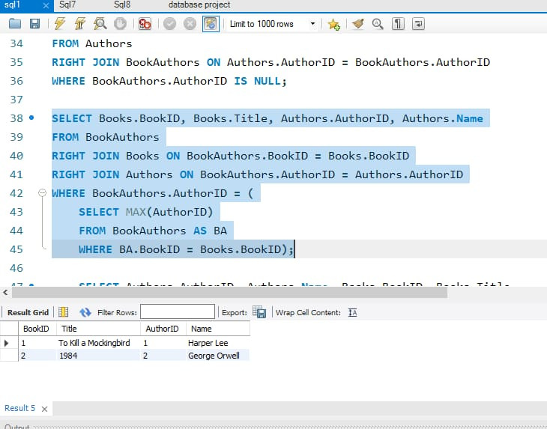
Table 3:

Slide 13
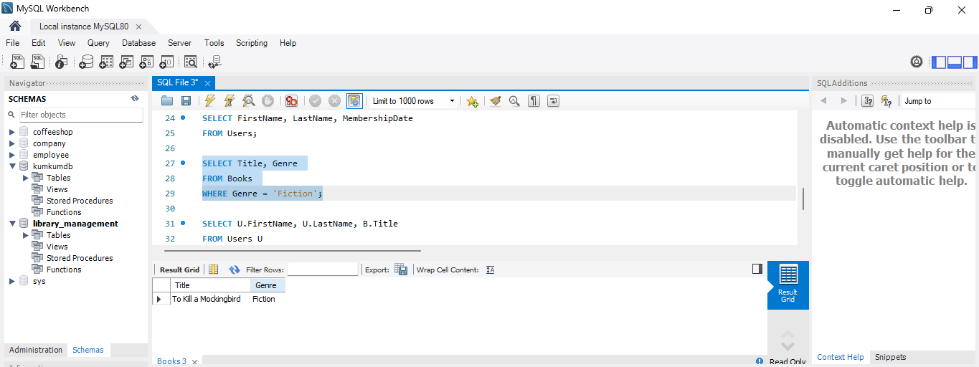
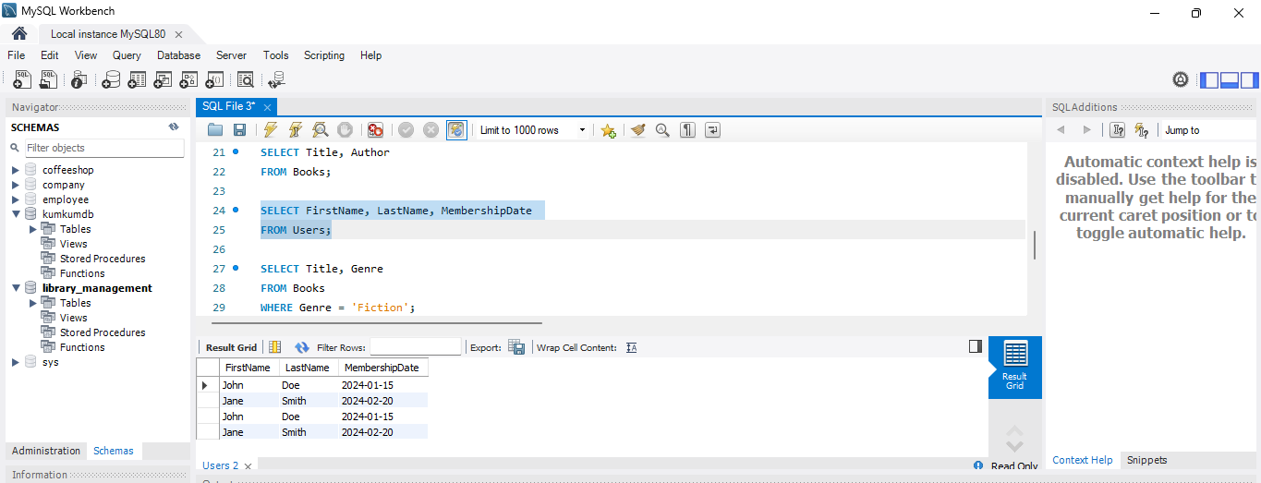
Kumkum:
1. Queries: Table 4:

Slide 14
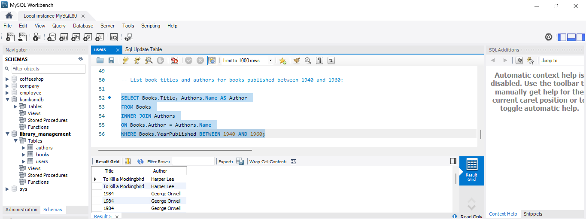
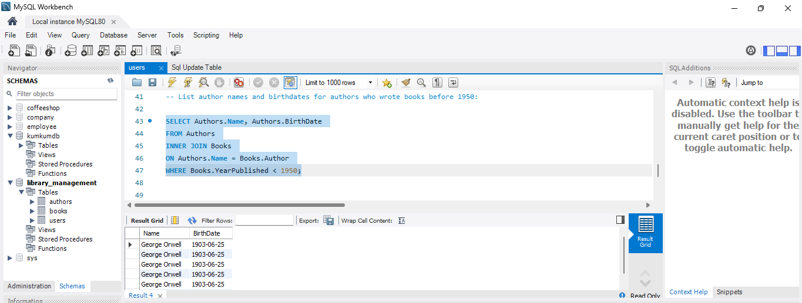
Table 5:

Slide 15
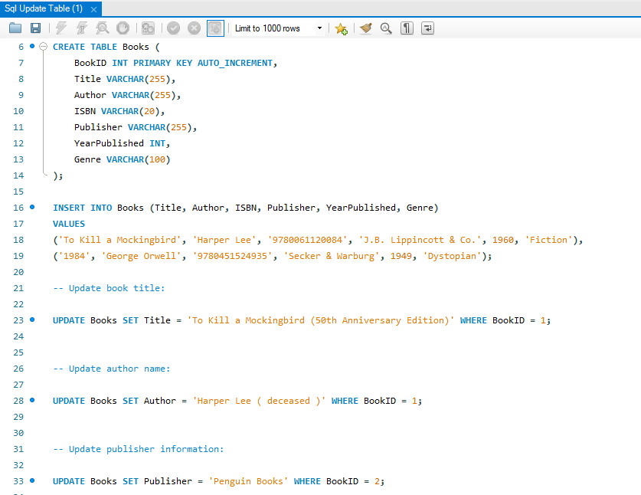
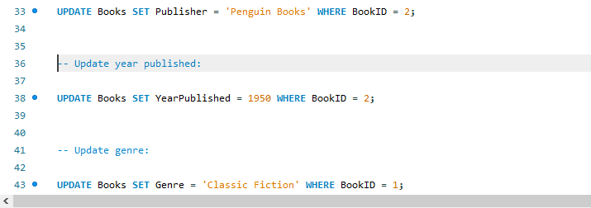
Table 6:

Slide 16
Hiba Zehra:
1. ER Model:

Slide 17
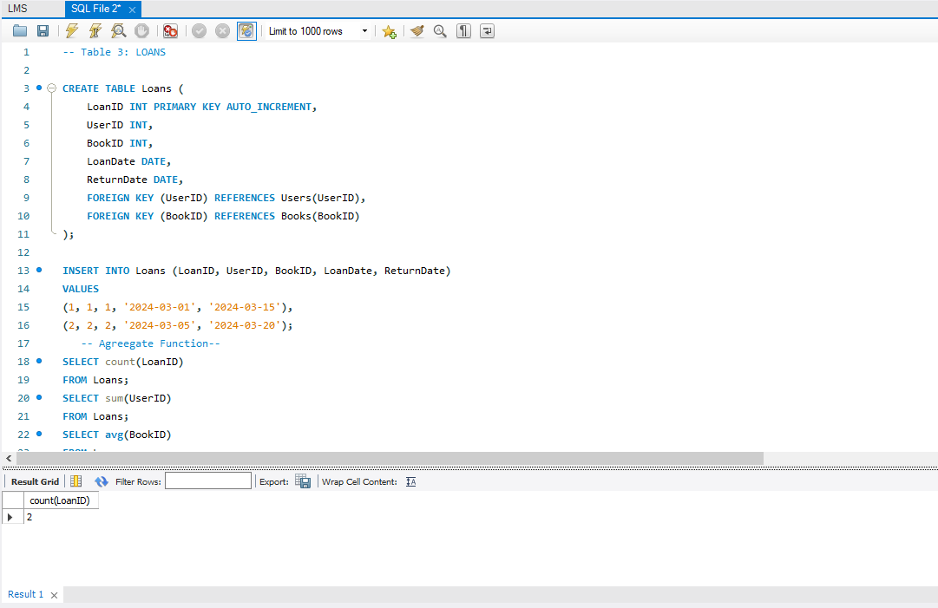
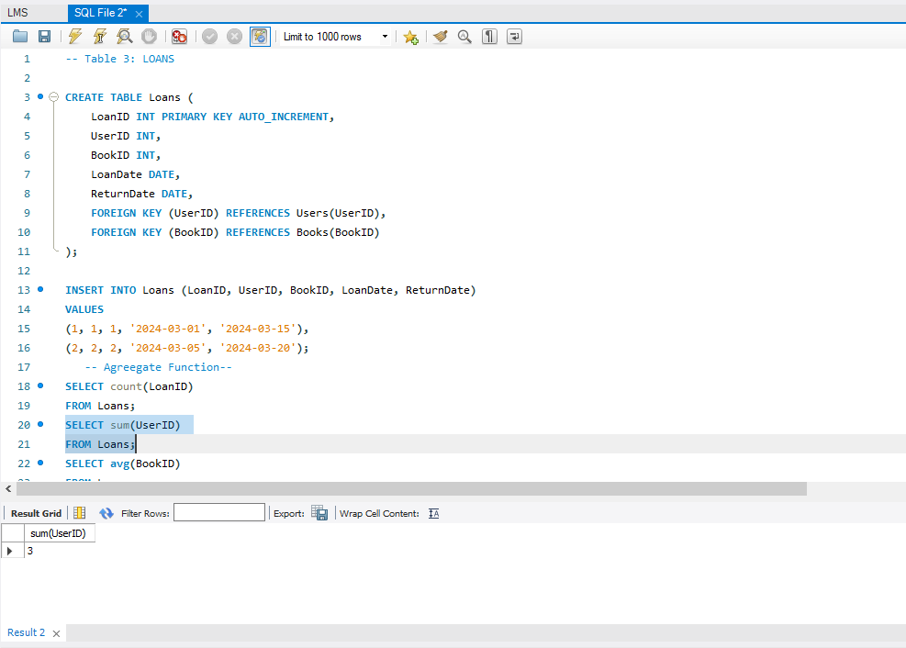
2. Queries:
Table 7:

Slide 18
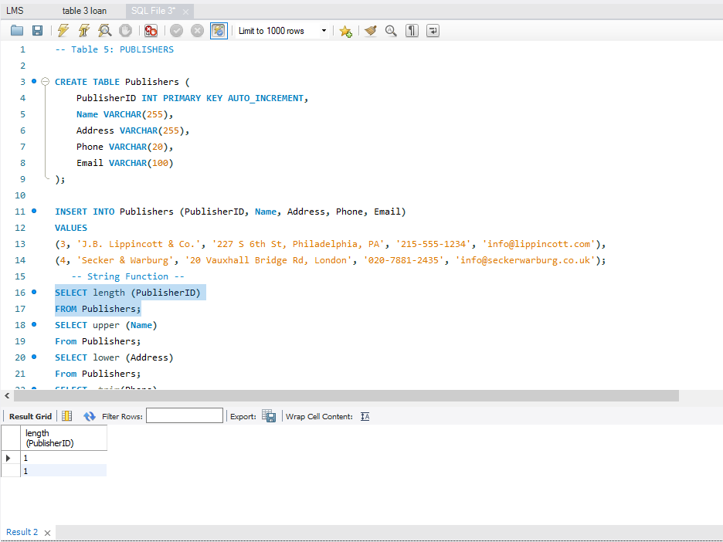
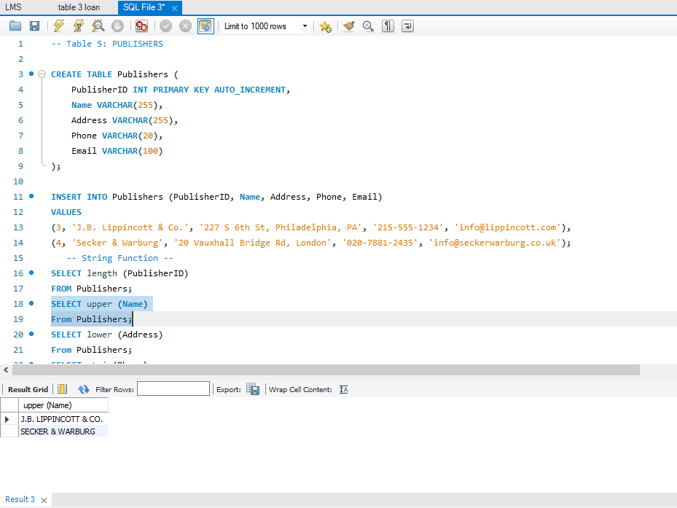
Table 8:

Slide 19
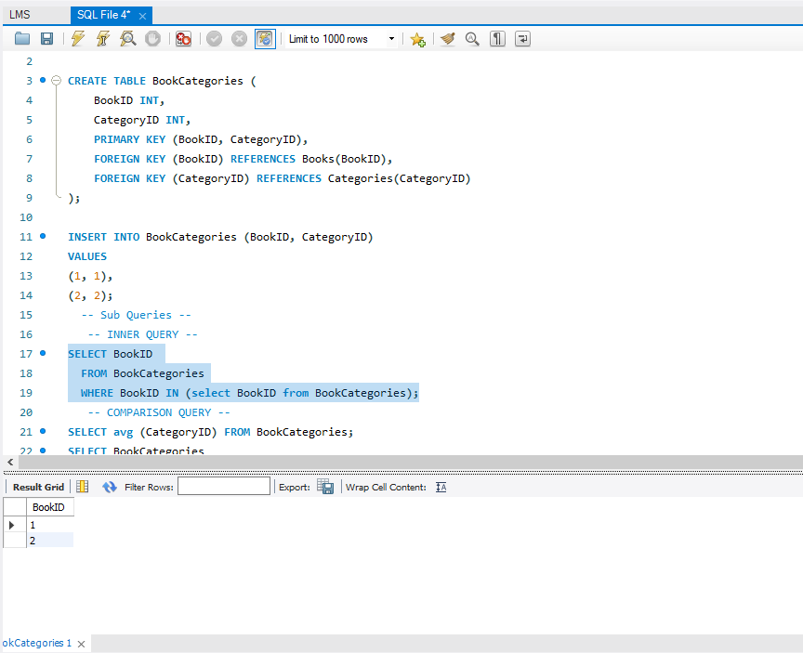
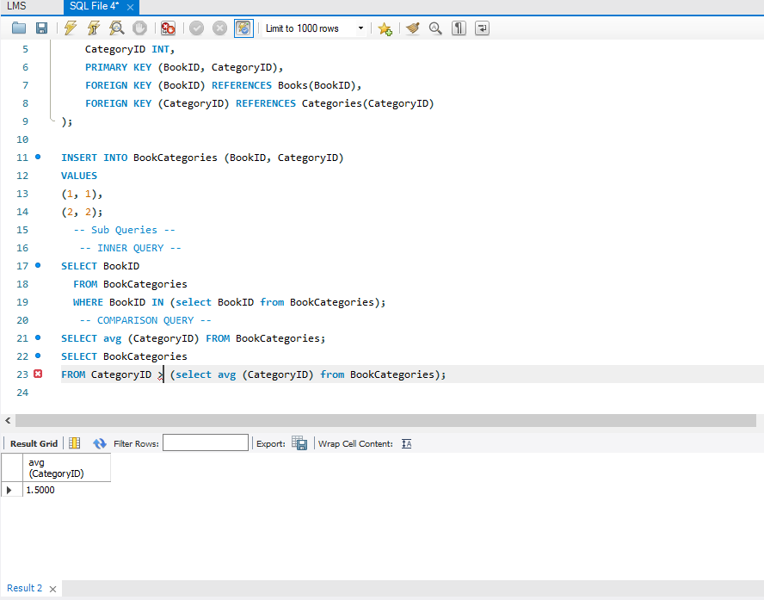
Table 9:

Slide 20
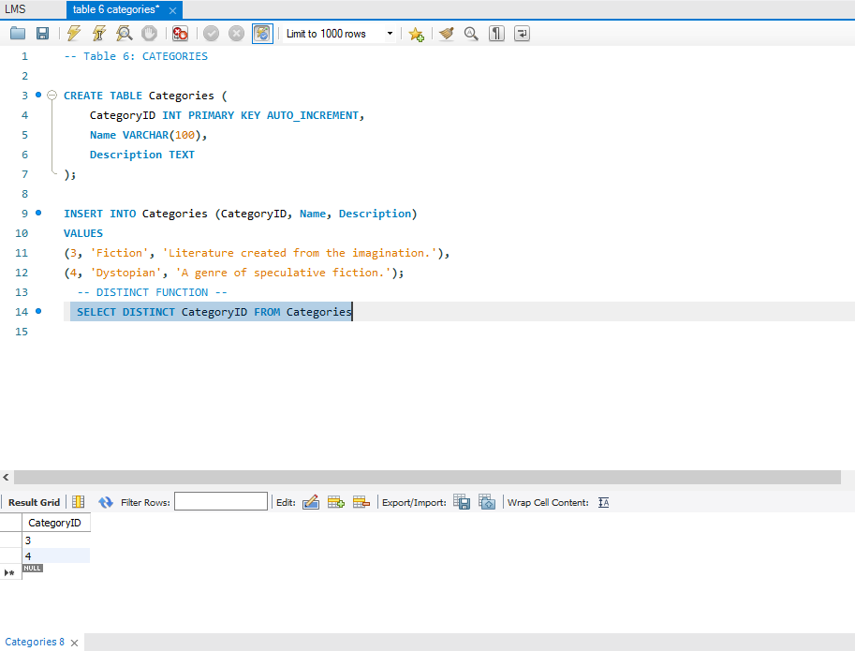
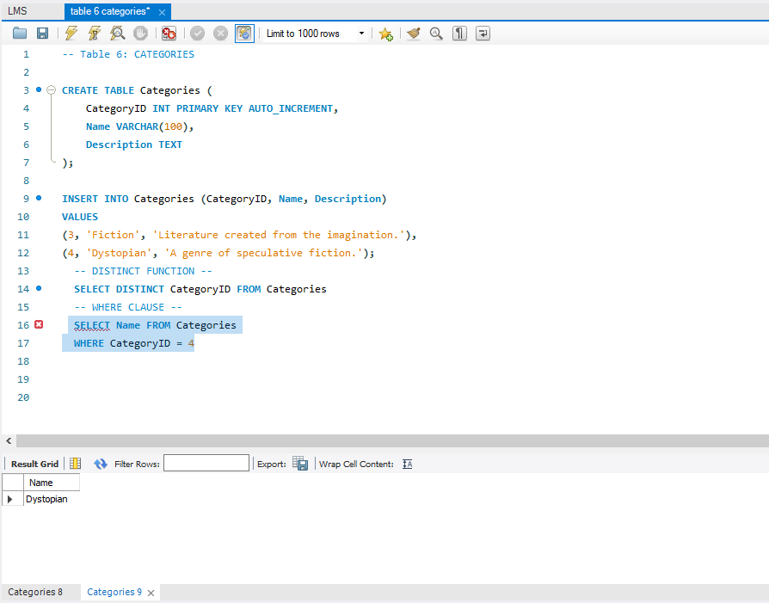
Table 10:

Slide 21
Purpose
To make the existing system more efficient.
To provide a user friendly environment.
Make functionalities of library faster.
Provide a system where the library staff can catch defaulters and not let them escape.

Slide 22
Advantages
It keeps the record.
Improves method of handling books.
Reduction of errors.

Slide 23
Application
Highly Secure, Scalable and Reliable.
Can be used in any library.

Slide 24
Conclusion
Library Management System is valuable tool for educational institutions, enabling efficient management of library resources and operations.

Slide 25
Thank you

